Slide 1

MySQL Workbench Installation: A Step-by-Step Guide
Subtitle
🌐 Strictly4data.ml

Slide 2
What is MySQL?
🌐 Strictly4data.ml
MySQL is a publicly accessible Relational Database Management System (RDBMS) that uses Structured Query language (SQL) to interact with databases. MySQL stores data in the form of tables that can be modified using Structured Query Language. Its adaptability with different computing systems like Windows, Linux, macOS, and Ubuntu which made it an easy-going RDBMS software option.

Slide 3

How to Install MySQL Workbench?
NOTE:
To change images on this slide, select a picture and delete it. Then click the Insert Picture icon
in the placeholder to insert your own image.
Moving on, you will look at how to install MySQL Workbench on Windows. The installation process is similar to other operating systems.
Open the MySQL website on a browser. Click on the following link: https://www.mysql.com/downloads/
Select the Downloads option.
🌐 Strictly4data.ml

Slide 4
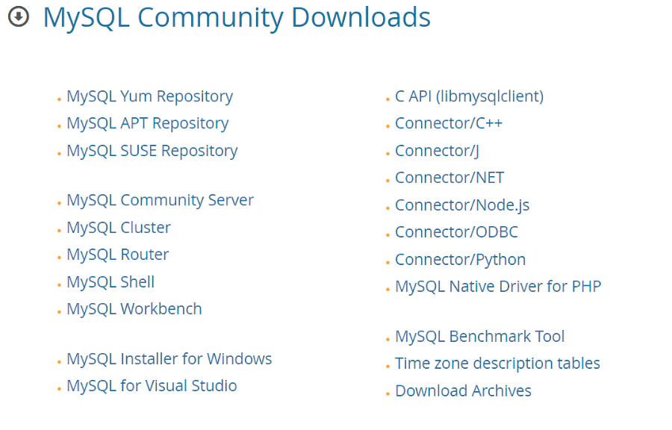
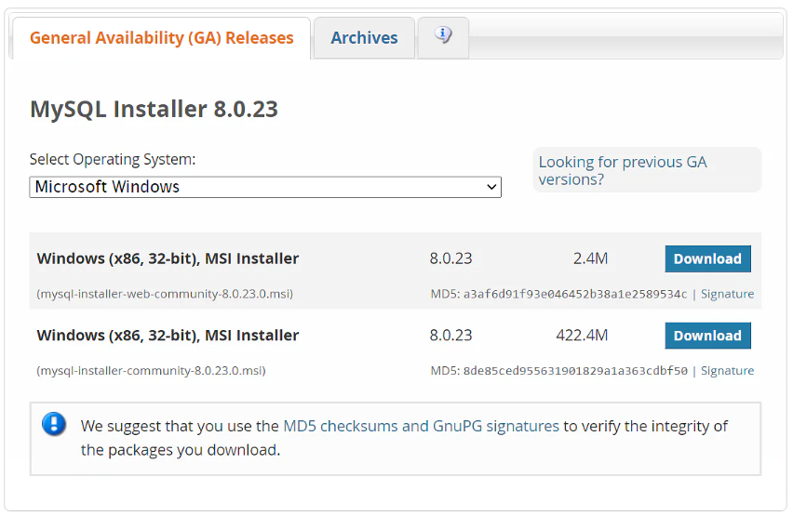
3. Select MySQL Installer for Windows.
4. Choose the desired installer and click on download.
🌐 Strictly4data.ml

Slide 5
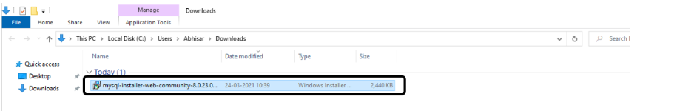
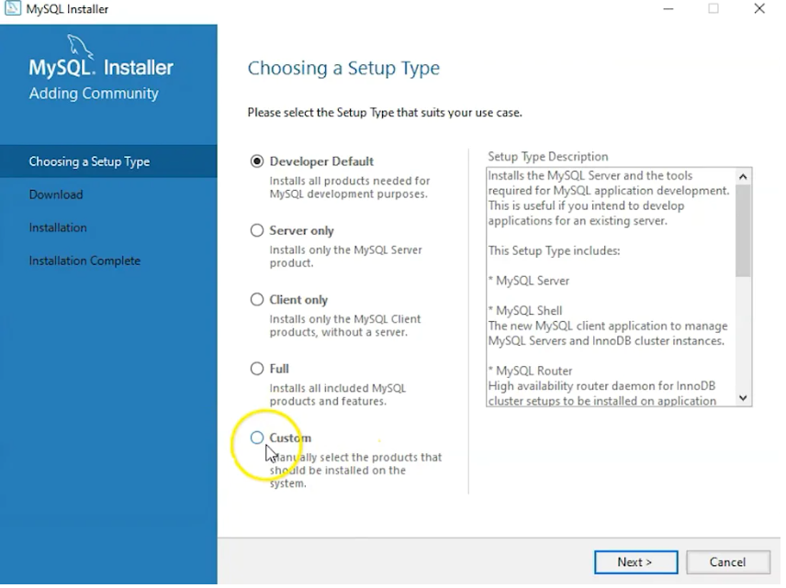
🌐 Strictly4data.ml
5. After the download, Double click to open the installer.
6. It will ask for permission; when it does, click Yes. The installer will then open. Now, it will ask to choose the setup type. Here, select Custom.

Slide 6
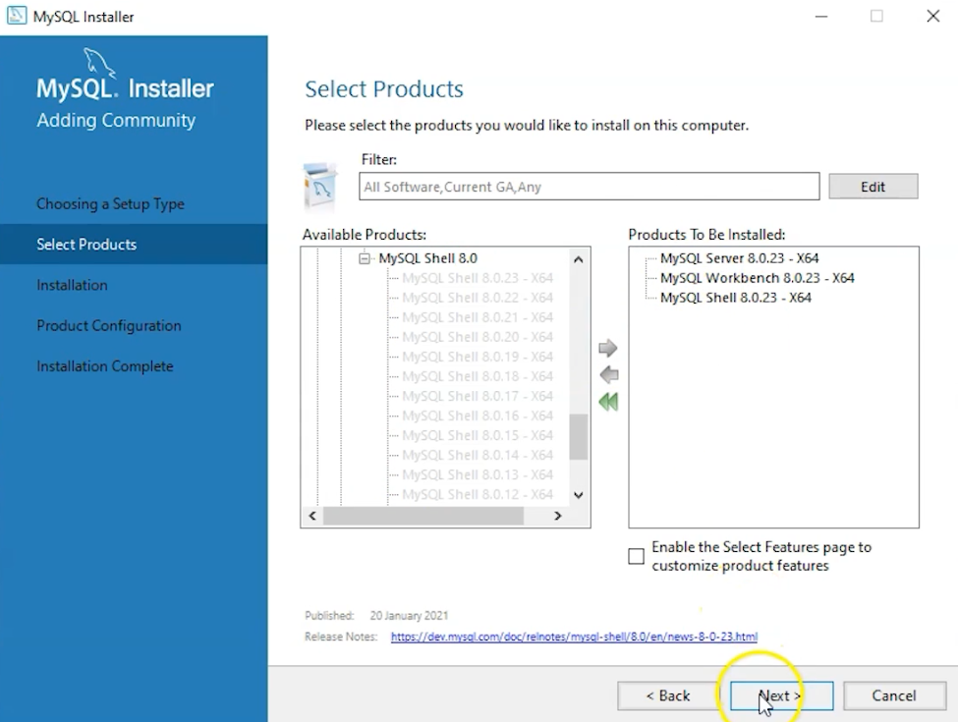
7. Click on Next. With this, you will install MySQL server, MySQL Workbench, and MySQL shell.
8. Open MySQL Servers, select the server you want to install, and move it to the Products/Features to be installed window section. Now, expand Applications, choose MySQL Workbench and MySQL shell. Move both of them to ‘Products/Features to be installed’.
🌐 Strictly4data.ml

Slide 7
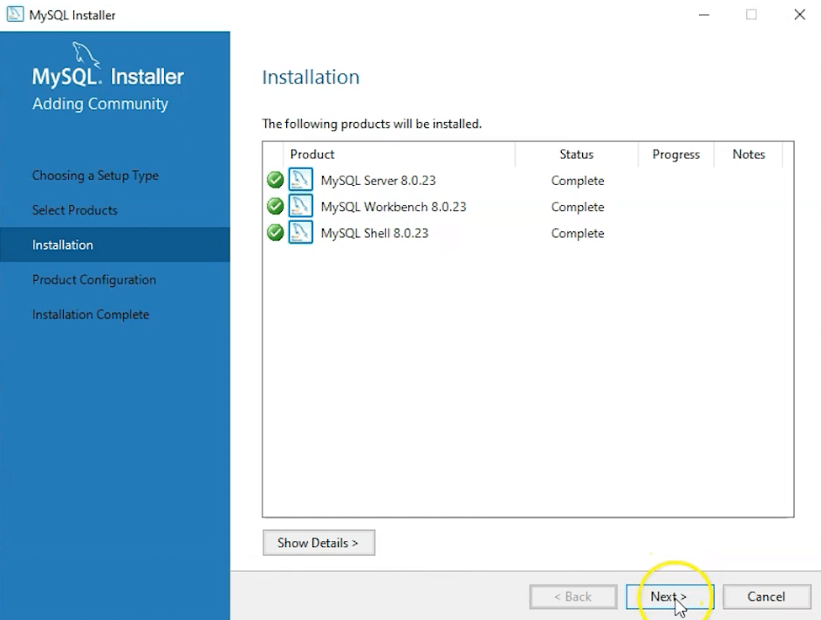
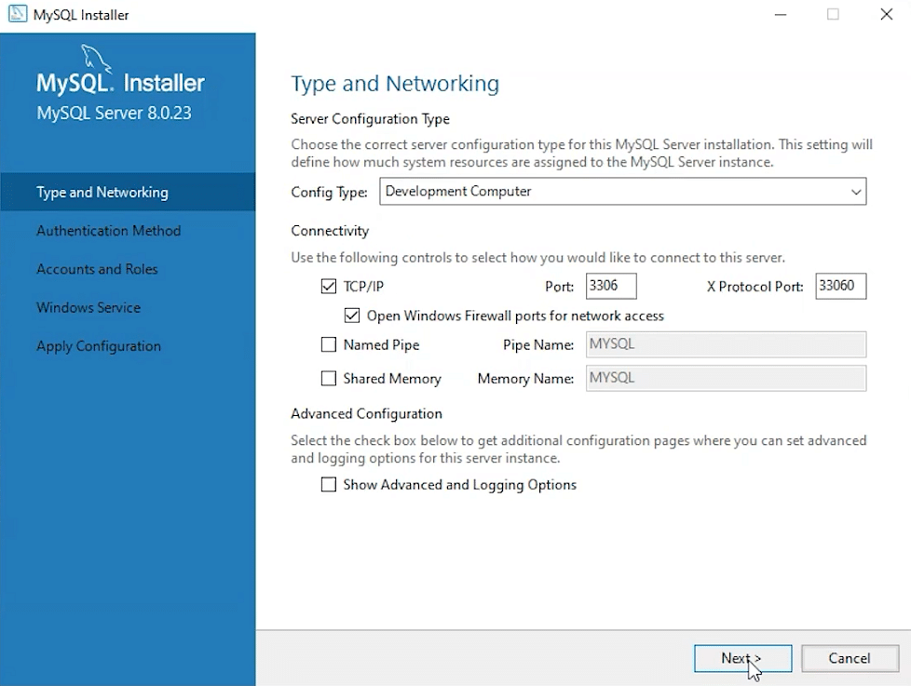
9. Click on the Next button. Now, click on the Execute button to download and install the MySQL server, MySQL Workbench, and the MySQL shell.
10. Once the product is ready to configure, click on Next. Under Type and Networking, go with the default settings and select Next.
🌐 Strictly4data.ml

Slide 8
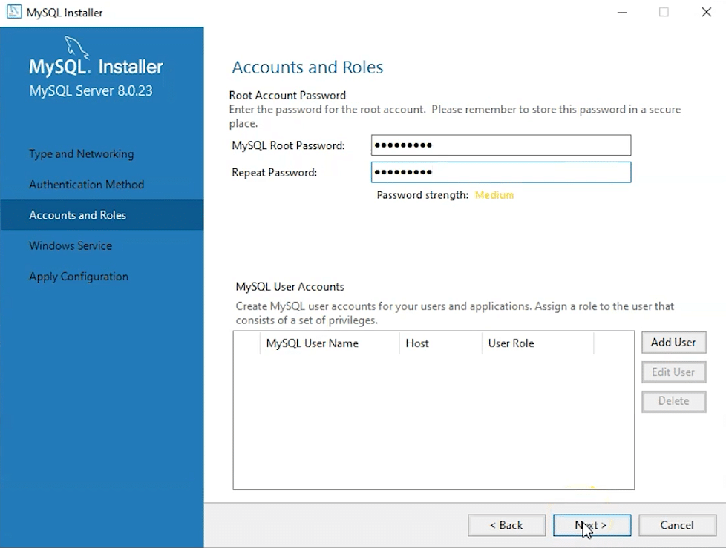
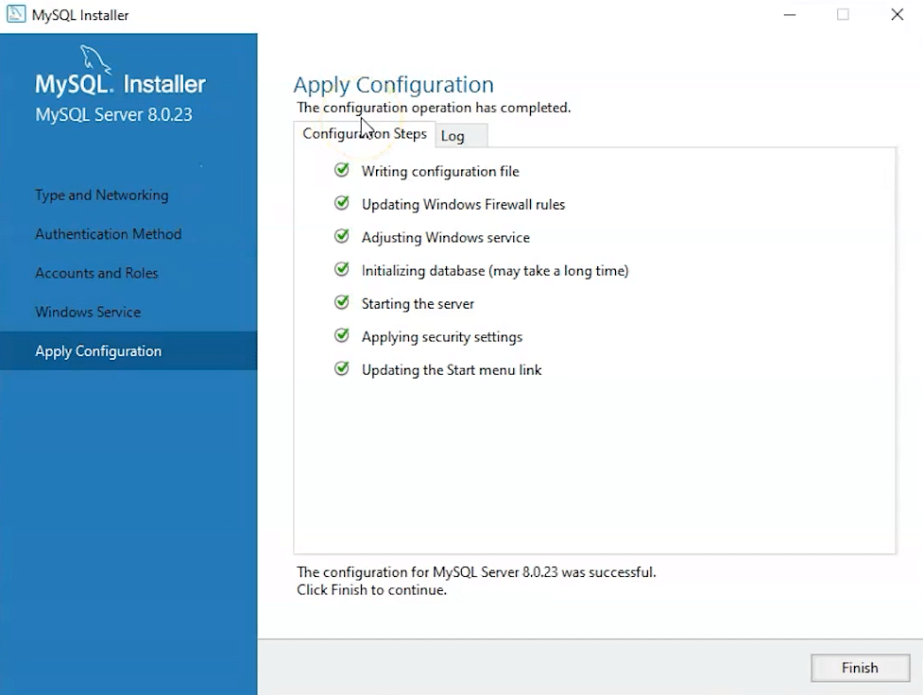
11. For authentication, use the recommended strong password encryption.
12. Set your MySQL Root password and click on next.
13. Go for the default windows service settings and under apply configuration, click on execute. Once the configuration is complete, click on finish.
🌐 Strictly4data.ml

Slide 9
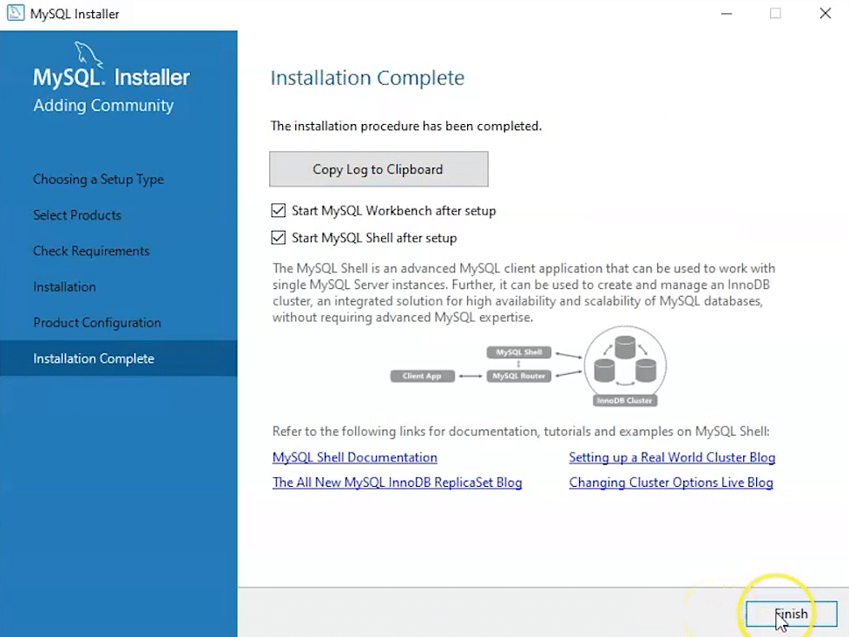
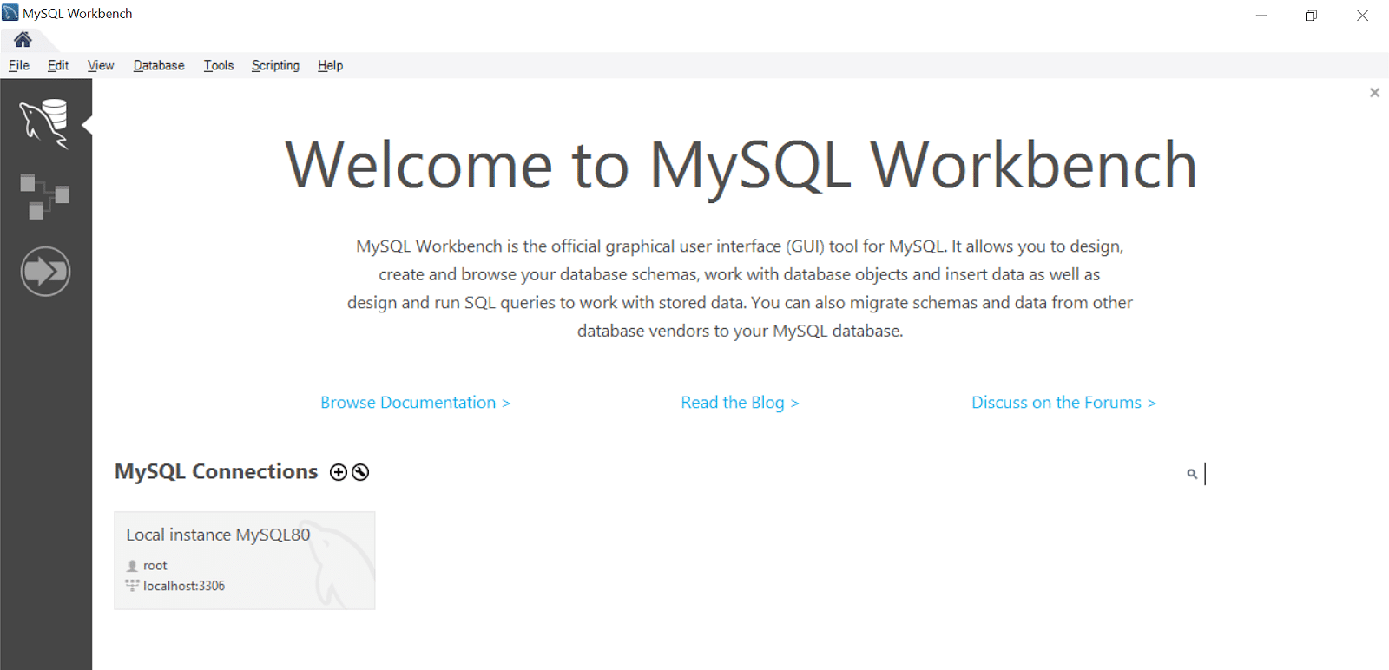
14. Complete the installation. This will now launch the MySQL Workbench and the MySQL Shell.
Once MySQL Workbench is installed, select the Local instance and enter the password.
Now, you can use the MySQL query tab to write your SQL queries.
🌐 Strictly4data.ml

Slide 10
🌐 Strictly4data.ml
Conclusion
With its comprehensive features, MySQL Workbench is a popularly used software by businesses to manage their structured databases.
In this presentation, you learned the steps to install MySQL Workbench on Windows.
Do you have any questions regarding the ‘MySQL Workbench’ installation? If you do, then please contact www.strictly4data.ml for Installation guide and Comprehensive Tutorials.

